Slide 1
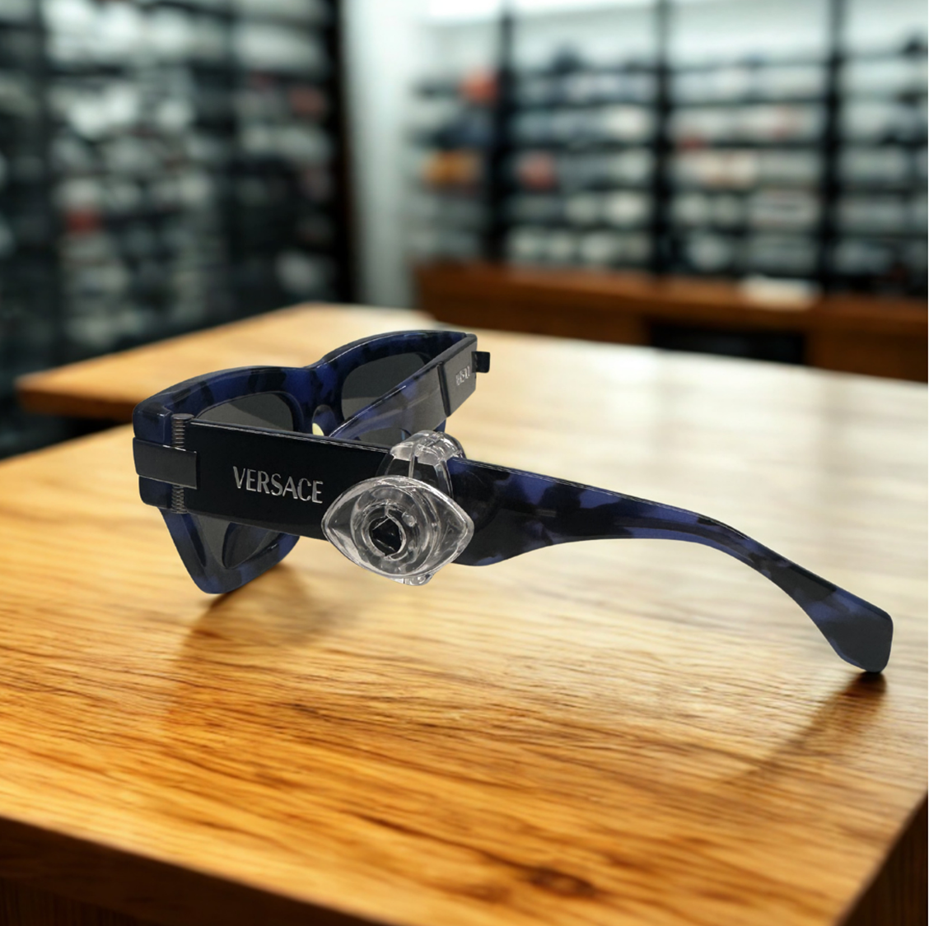

EAS Solutions for
Essilor Luxottica

Slide 3
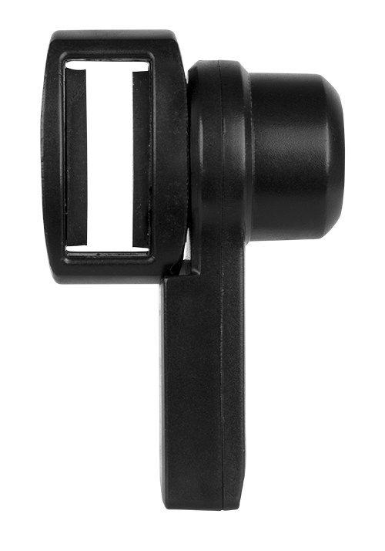
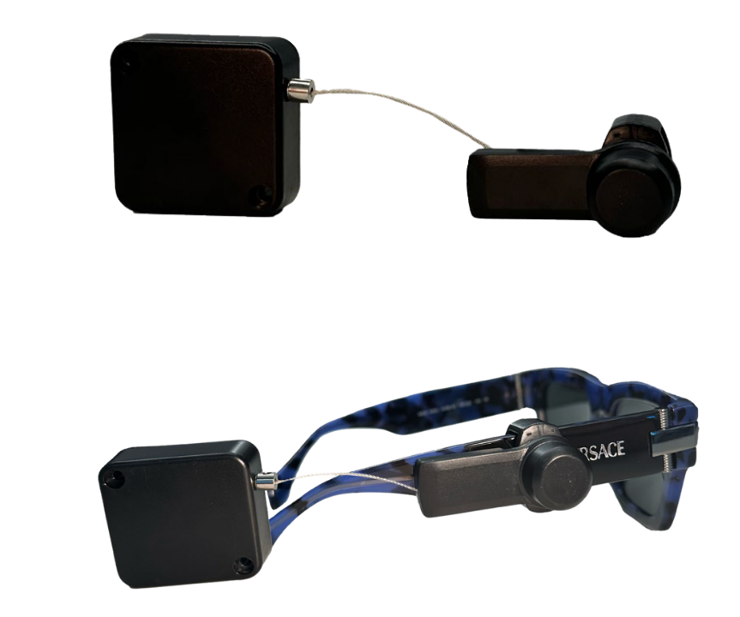
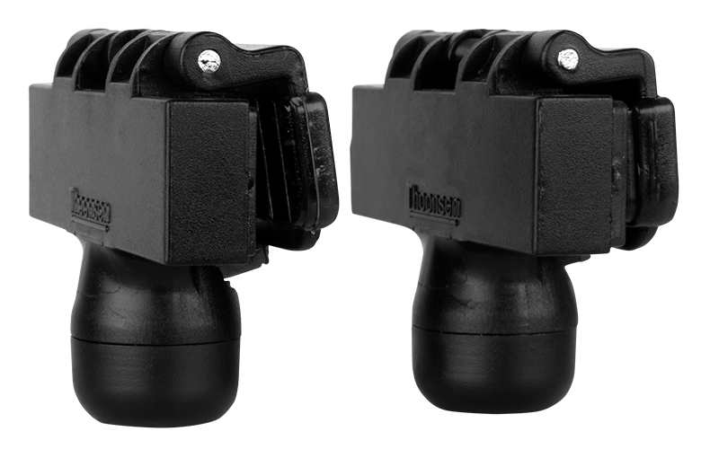
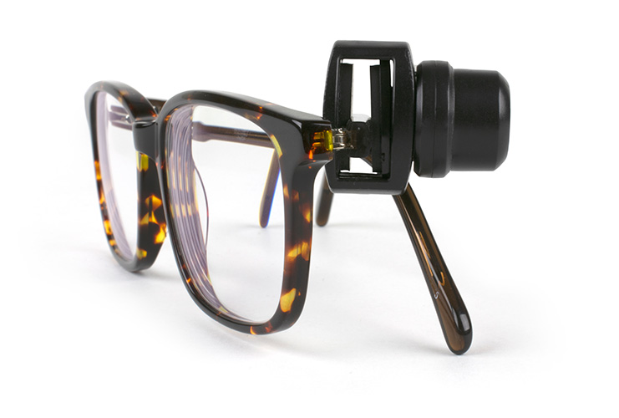
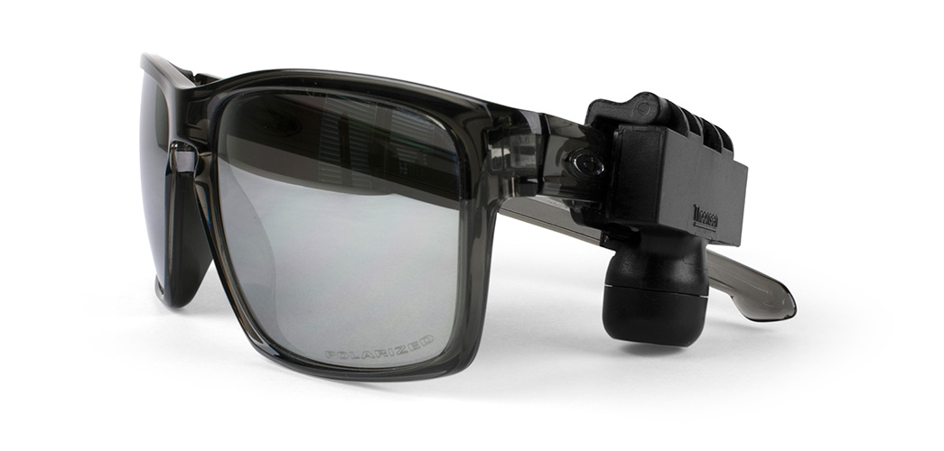
EYEWEAR PROTECTION FOR ESSILOR LUXOTTICA
OptiTag
Retractable OptiTag
QuickOptical

Slide 4
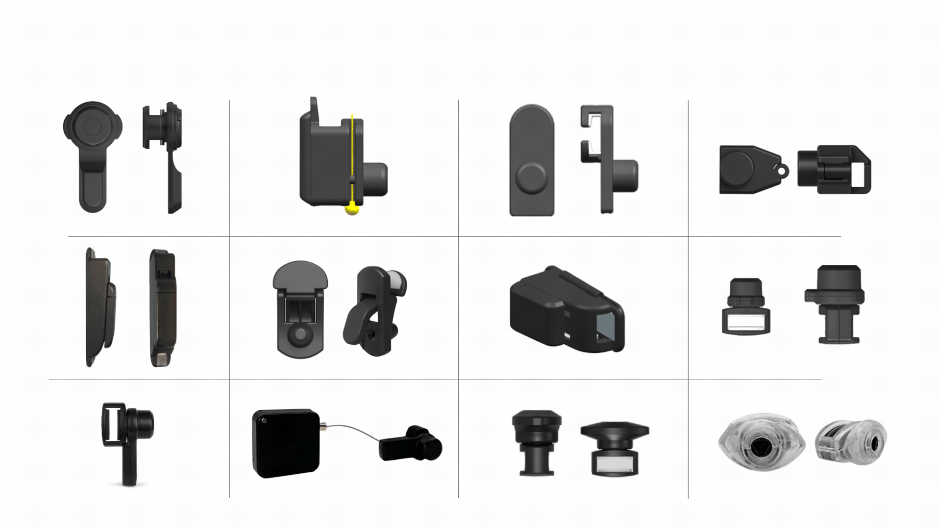
DESIGN THINKING METHOD IN ACTION…RAPID PROTOTYPING
DEVELOPMENT OF THE NEW EYEWEAR TAG FOR ESSILOR LUXOTTICA

Slide 5

INTRODUCING
LUXEYE™

Slide 6
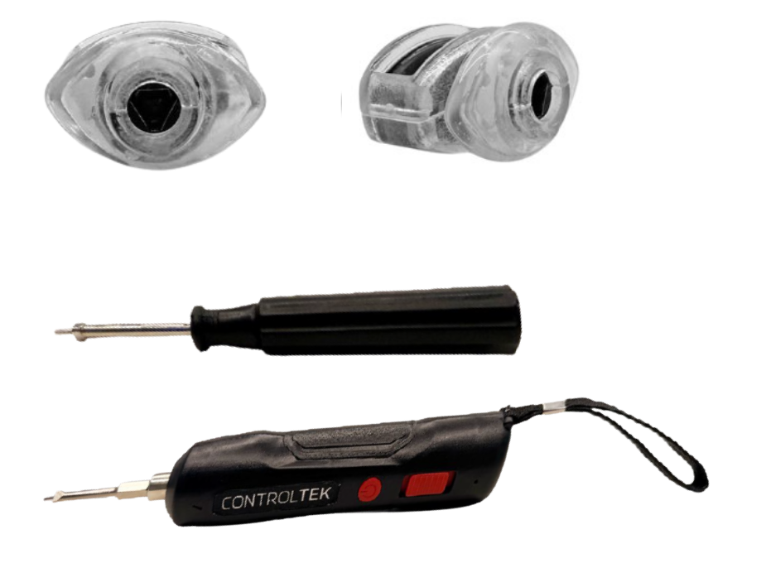
LUXEYE™
PRECISION SECURITY FOR HIGH-VALUE EYEWEAR
Key Benefits
Designed for wider, thicker temple frames
Secure, non-damaging grip for premium eyewear
Mechanical locking system helps reduce unauthorized removal
Strong visual deterrent at the shelf
Easy, controlled application and removal with dedicated tool
Maintains open merchandising without bulky lockboxes

Slide 7
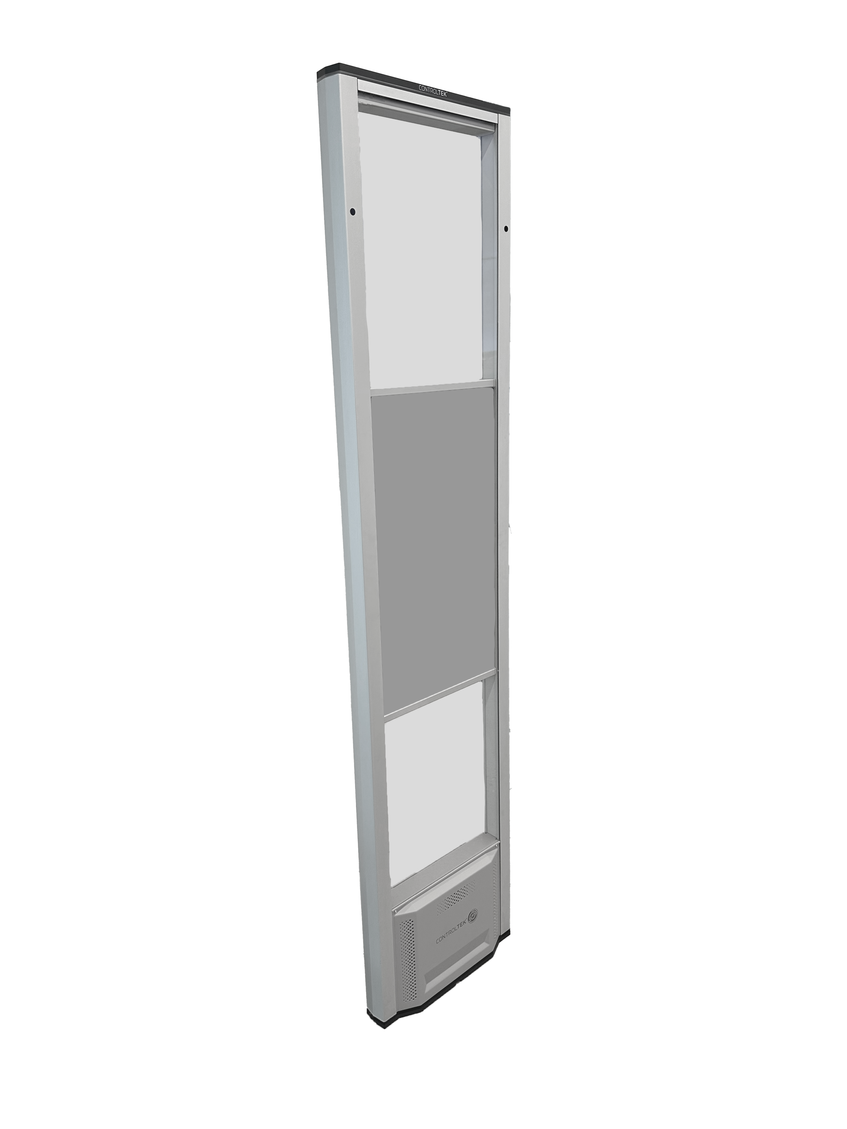
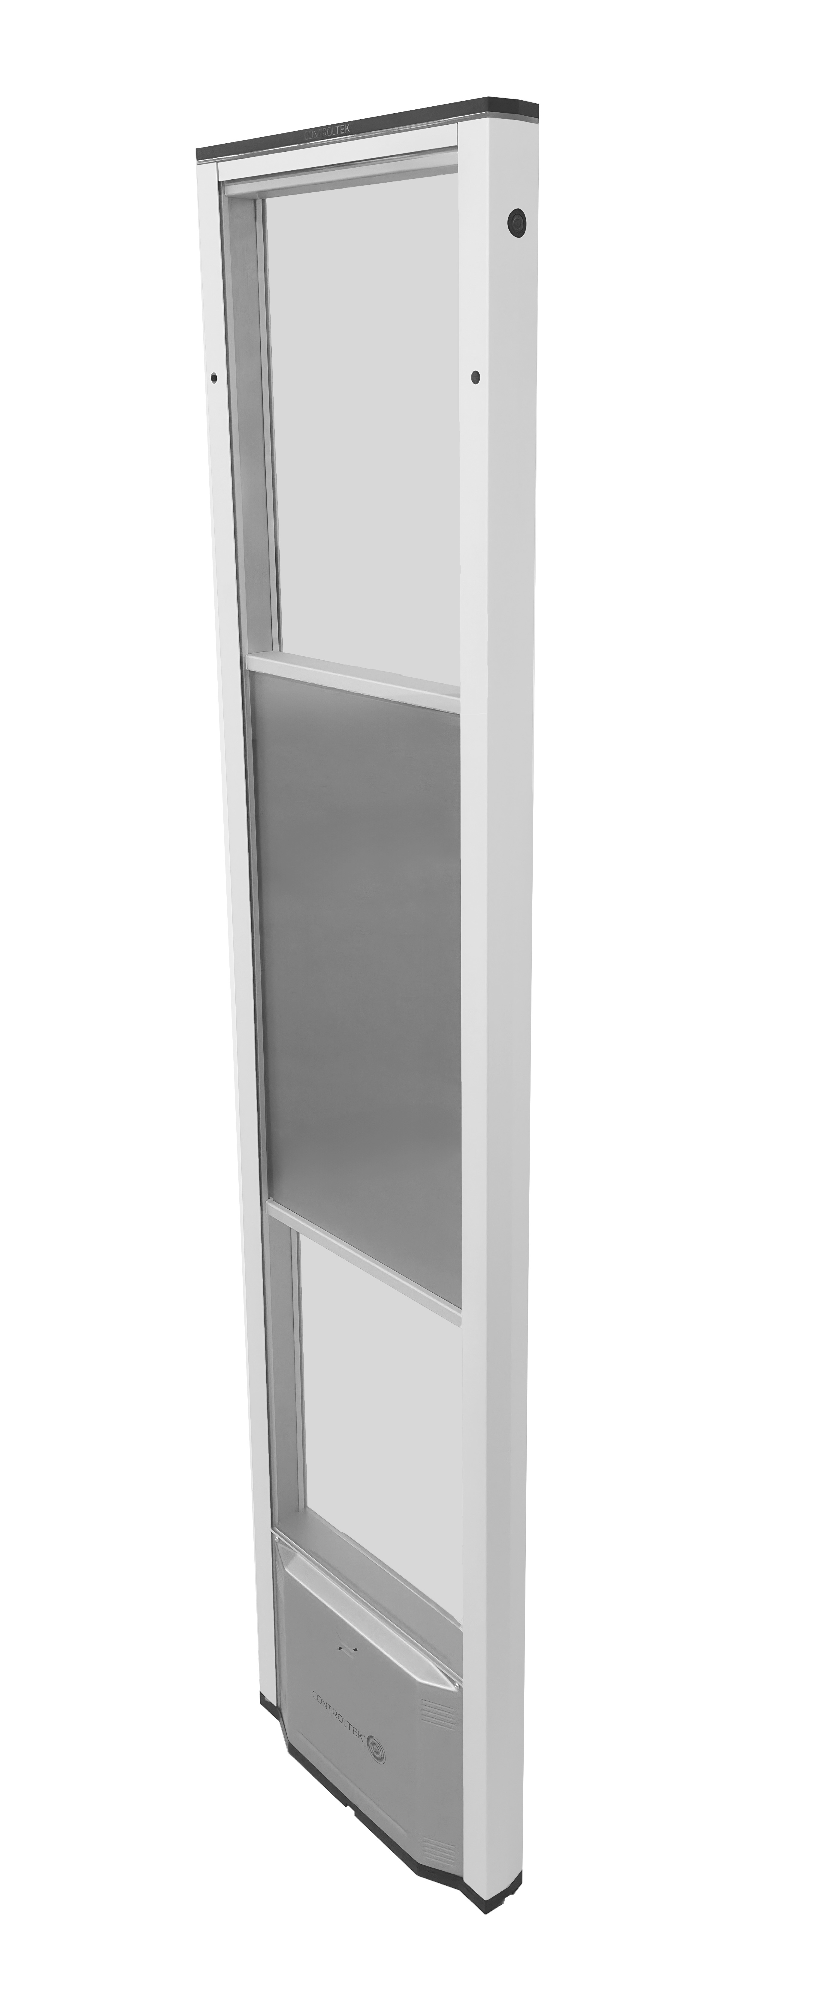
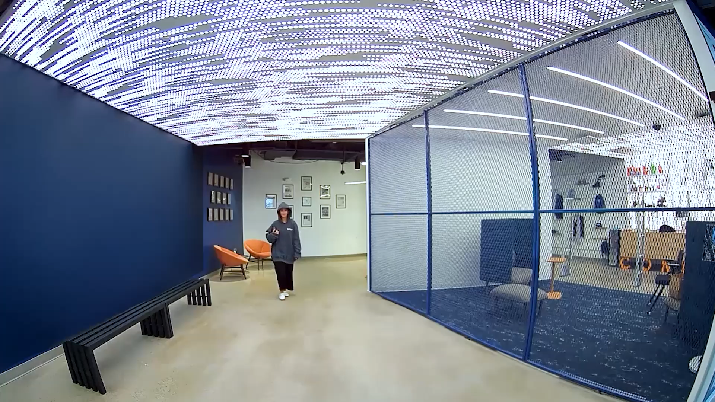
AM SYSTEMS WITH RFID

Slide 8

From Insight to Action:
AI Tools for Asset Protection Professionals

Slide 9
HOW IT WORKS
It might make mistakes or “hallucinate” based on the limitations of its process, but the output still might look like what you wanted
Generative AI
(admittedly oversimplified)
TedChiang’s analogy = “unreliable photocopier” or a “blurry JPEG”
Training
Data
To build the system
Chat
Doc
Data
Testing
Data
To check the correctness of the system
Image
Source: An introduction to Generative AI | Cori Faklaris
Notes:
Generative AI: Predictive Chat GPT is like a creative robot that learns from lots of examples and then uses that knowledge to make new things by itself. Can create all on its own, using what it has learned.
2015 Chatgpt – LLM like spell check

Slide 10

Generative AI
Input
AI Model
Output
Email
Spam?
Inbox
Transaction
Approve/Decline
Fraud?
Prompt:
Write me a blog post on . . .
Create a new song in the style of . . .
Write code to do . . .
Create a picture of a cat wearing a baseball hat. . .
Output:
Notes:
Red, White, Blue
Peanut Butter & Jelly
Generative AI: Predictive Chat GPT is like a creative robot that learns from lots of examples and then uses that knowledge to make new things by itself.

Slide 11

REASONING
Allows AI to show its reasoning process step-by-step, making its interactions more transparent, logical, and explainable, moving beyond simple text prediction to structured problem-solving.
Notes:
Allows Open AI to show its reasoning process step-by-step, making its interactions more transparent, logical, and explainable, moving beyond simple text prediction to structured problem-solving.

Slide 12
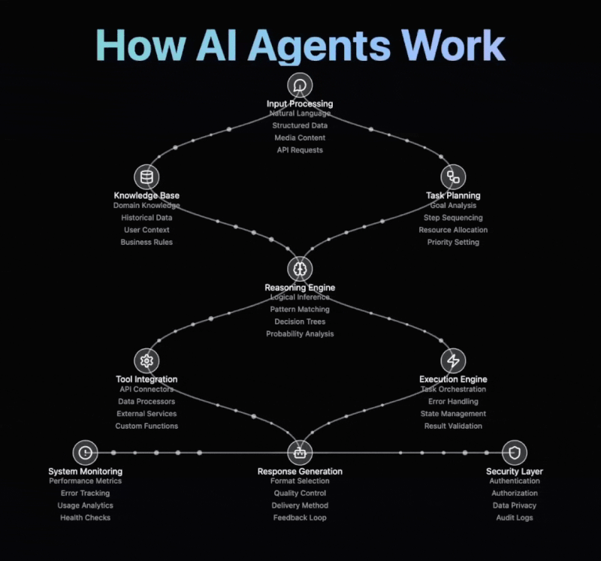
AGENTS
Core architecture of AI Agents:
Processes & Understands Input – Interprets user queries and extracts relevant context.
Leverages Knowledge & Reasoning – Uses historical data, logical inference, and domain expertise to generate insights.
Executes & Optimizes Actions – Connects with tools, orchestrates tasks, and delivers the best response while tracking performance.
Notes:
How AI Agents Work
Input Processing
Knowledge Base Integration
Task Planning
Reasoning Engine
Tool Integration
Execution Engine
Response Generation
System Monitoring
Security Layer

Slide 13
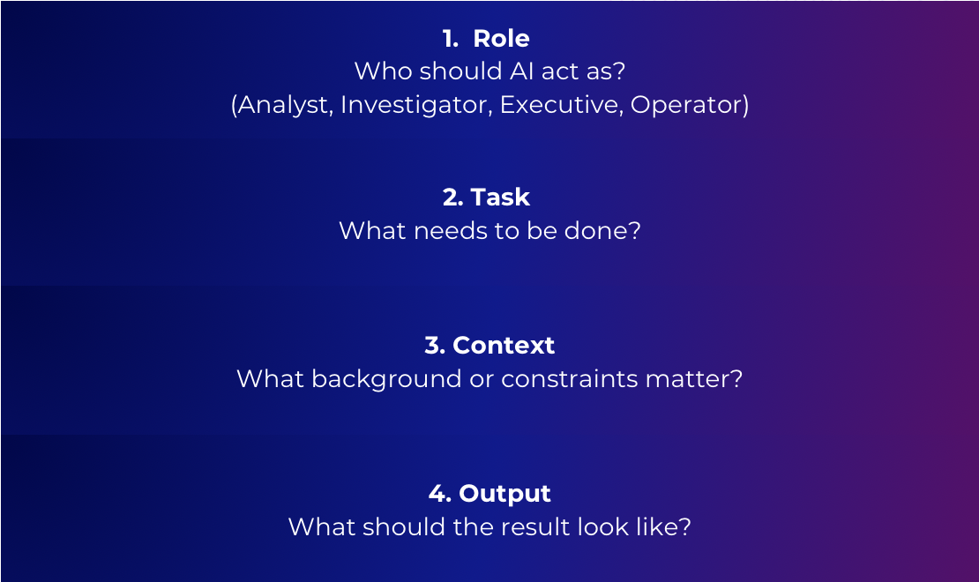
The Prompt Framework
Every effective prompt includes four key elements:
Example:
Basic Prompt:
  Summarize this report
Structured Prompt:
  Act as a security analyst. Summarize this report for executive leadership in 5 bullet points and highlight key risks.
Best Practices:
Be clear and specific
Provide relevant context
Define the format of the output
Set constraints (length, tone, structure)
Refine prompts based on results

Slide 14


PROMPT ENGINEERING
Prompt engineering is the practice of writing inputs, to interact with generative AI (gen AI) models.
Streamline processes, and make data-driven decisions with greater precision.
Empowers businesses to leverage AI tools and systems effectively, enabling them to stay competitive in a rapidly evolving digital landscape.
Notes:
Prompt Engineering

Slide 15
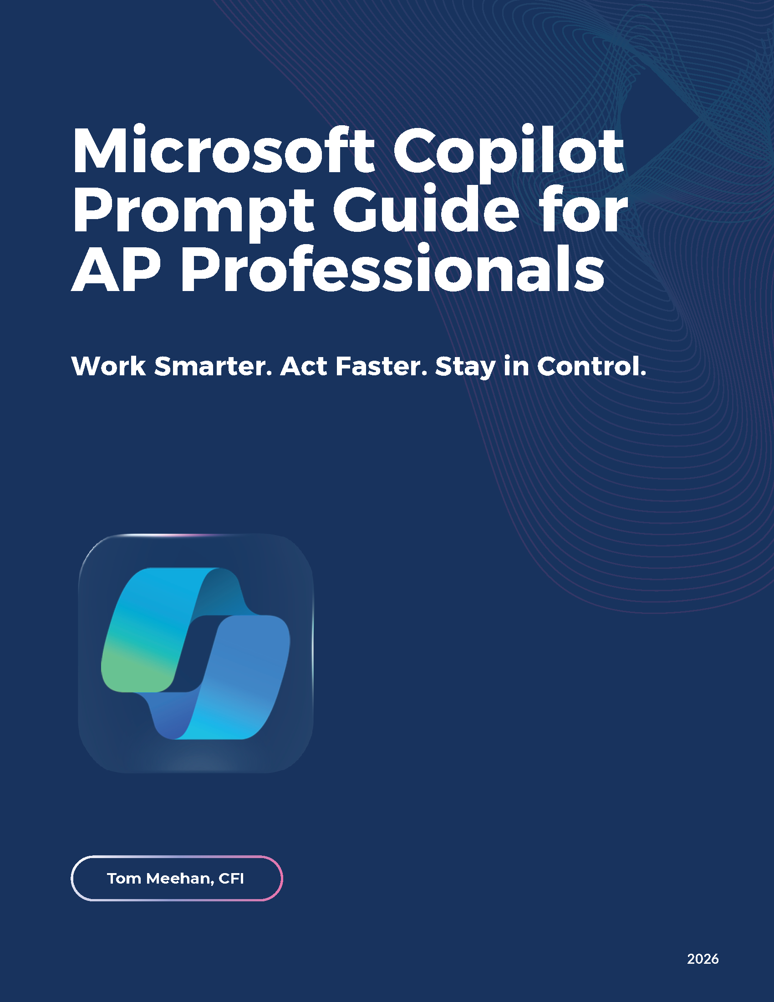

DOWNLOAD THE GUIDE
https://content.controltekusa.com/microsoft-copilot-prompt-guide-for-ap-professionals

